Slide 1
Applications of Fingerprint Classification using Deep Learning
Deep Learning in Signal Image and Processing
21AIE312
Notes:
Line spacing + Page numbers

Slide 2
Table of Contents
01 Introduction
02 Dataset
03 Methods & Models
04 Results
05 Conclusions

Slide 3
Introduction
01
Fingerprints are generally used biometric authentication system. Fingerprints are unique and statistically differ between gender and age categories. In our model, using fingerprints, we identified fingers, hand as well as gender. We used CNN models to train and evaluate fingerprints.
Liveness of the fingerprint is also classified based on the data
The main use is time reduction. Classifying gender reduces time significantly, furthermore by understanding the hand as well as position of finger, the time spent in identifying the culprit in a large volume database is reduced. In addition, predication of the level of alteration is also done.

Slide 4
Dataset
02

Slide 5
SOCOFing
Sokoto Coventry Fingerprint Dataset
Consists with all 10 fingerprints of 600 people.
Out of 600, there are 477 male and 123 female
A total of 6000 fingerprint images are labeled as real.
Real & Altered
Each of 6000 fingerprints is altered further into three levels: easy, medium, hard
In each level, the type of alterations done is obliteration, central rotation, Z-cut
There are a total of around 49000 fingerprints obtained through alterations

Slide 6

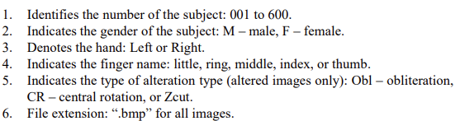
Data Structure
The file format contains different information regarding the image.

Slide 7
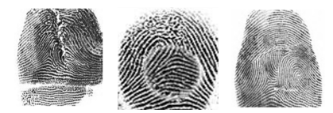
Alteration
Obliteration It is basically the distortion produced The obliteration can be carried out by abrasion, cuts, burns
Central Rotation Central Rotation appears when the patch, even from other fingers, is replanted in place with a rotation.
Z-Cut Z-cut is caused by a more complex process consisting of three steps: making a Z-shaped cut on the fingertip, lifting and switching two triangular skin patches, and stitching them back together.

Slide 8
Four Methods
03
Methods and Models
Liveness Detection Training the dataset based on real and altered images in order to identify the difference between real and fake fingerprint
Gender Classification Performed CNN on a subset of the data so that there is no data imbalance i.e., out of 477 males, only 123 males are considered.
Hand and Finger Identification Training till the first 400 persons’ altered data and testing it on the unseen & remaining 200 persons’ real data
Alteration Identification Performed CNN on all the set of alteration data with class label as the level of alteration done on the real data.

Slide 9
Liveness Detection
We combined 2,000 random fingerprint images from the three types of alterations; easy, medium; and hard with the real fingerprint image data of size 6,000 to obtain a final liveness data of size 12,000.
This data will be split into train, test, and validation and results are obtained.

Slide 10
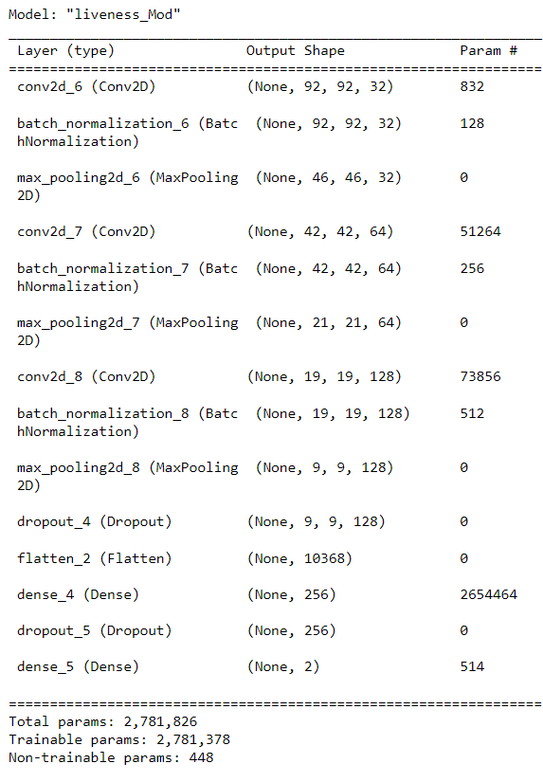
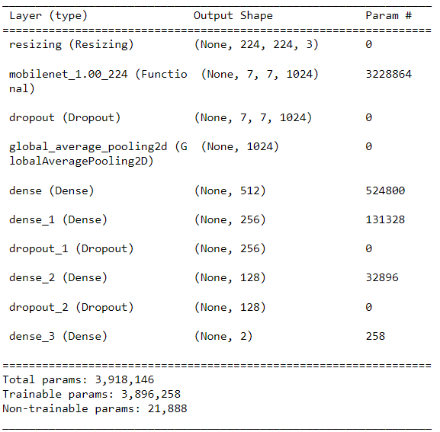
Models

Slide 11
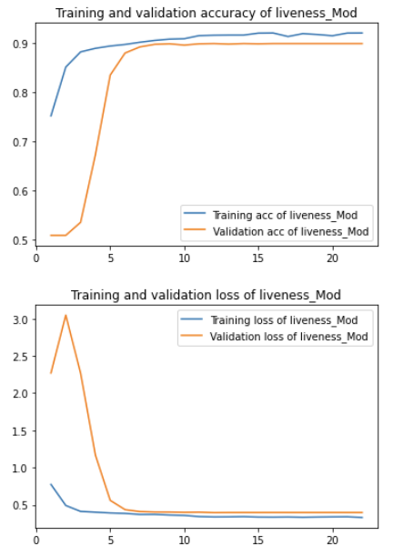
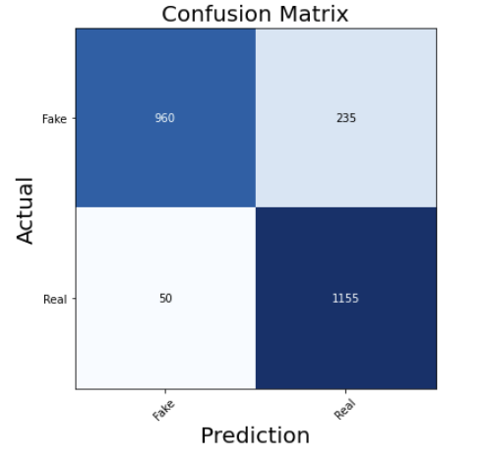
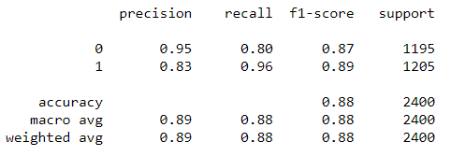
CNN Results

Slide 12
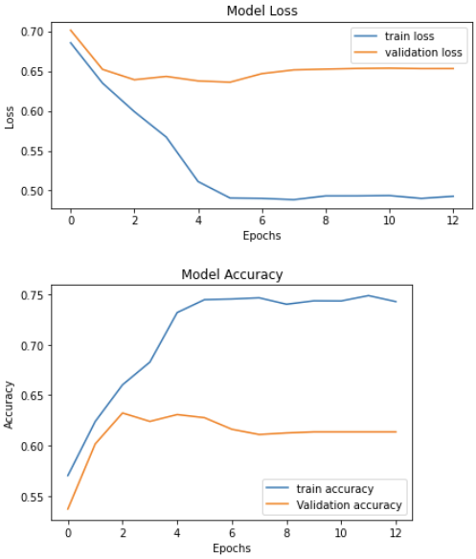
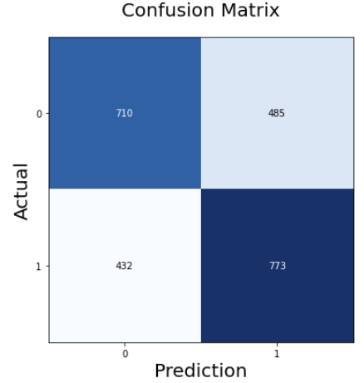
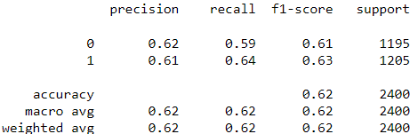
MobileNet Results

Slide 13
Finger Identification
For, this problem we considered both Real and Altered data.
The training data contains ID : 0 to 400 from altered data and testing data contains ID: 401 to 600 from the real data which is totally unseen by the model.
The predictions are also explained visually through a custom function.

Slide 14
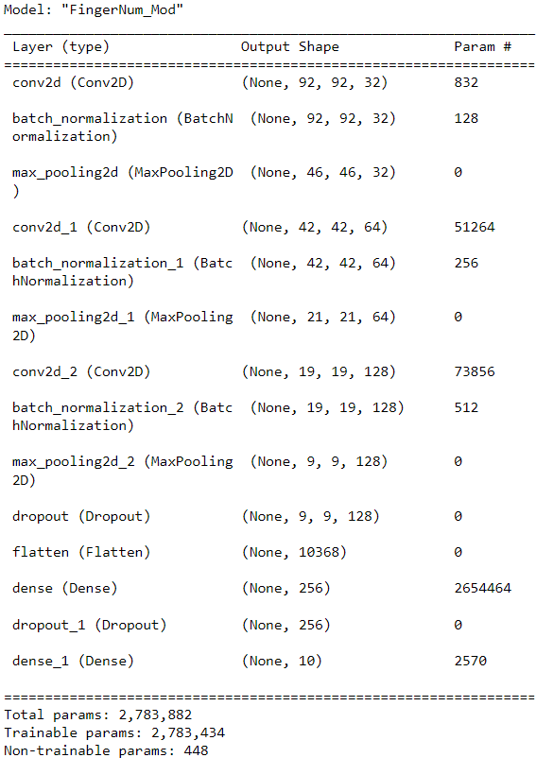
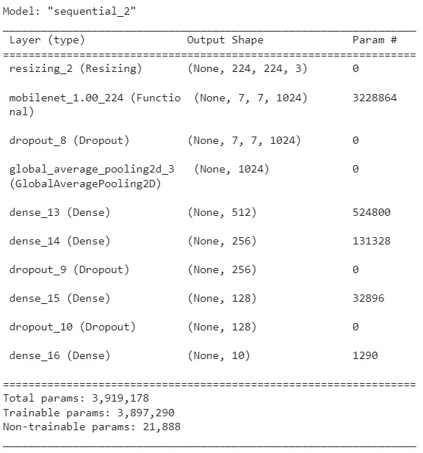
Models

Slide 15
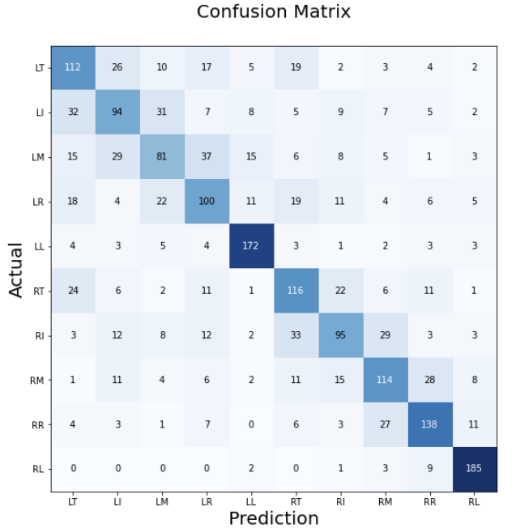
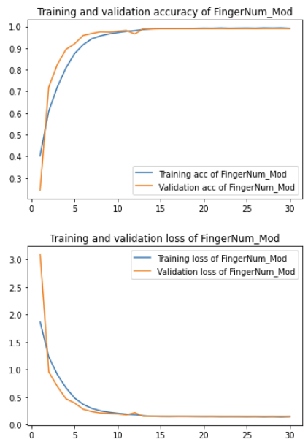
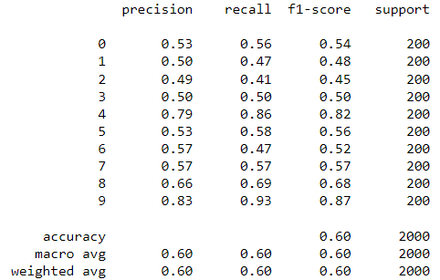
CNN Results

Slide 16
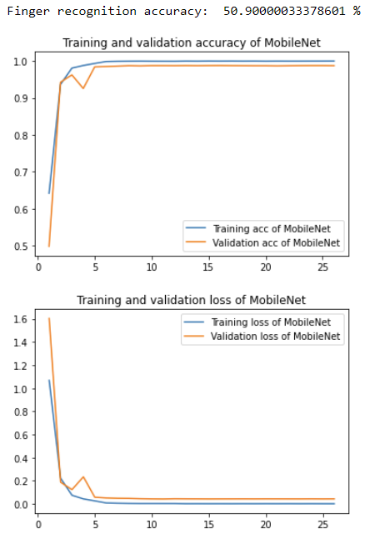
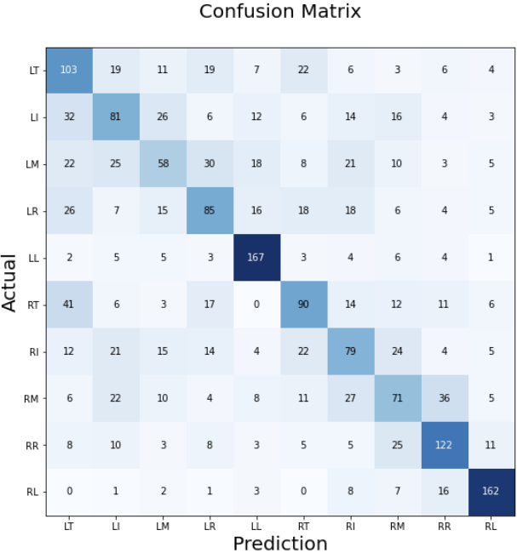
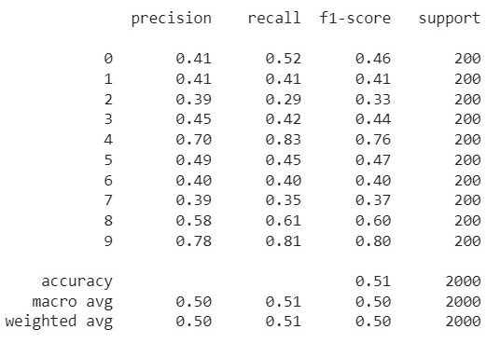
MobileNet Results

Slide 17
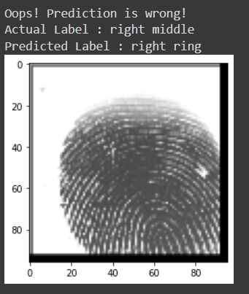
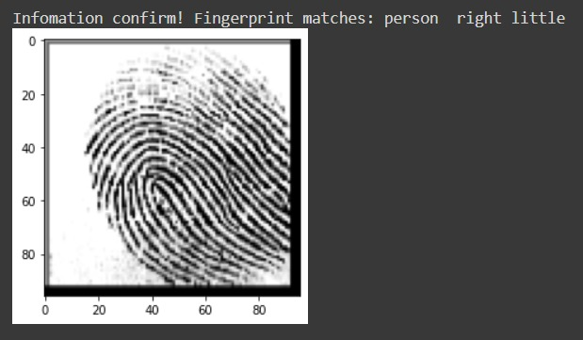
Predictions

Slide 18
Gender Classification
This problem only uses real data which contains 4770 Male fingerprints and 1230 Female fingerprints.
To avoid data imbalance, we considered 1230 random fingerprint images from both classes i.e., Male and Female.
This data containing 2460 samples are split into train, test, validation and fed to the model.

Slide 19
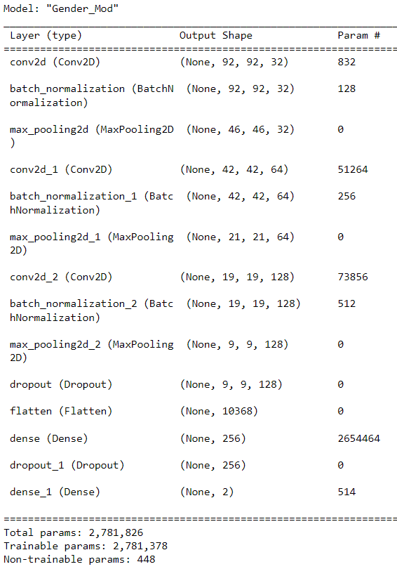
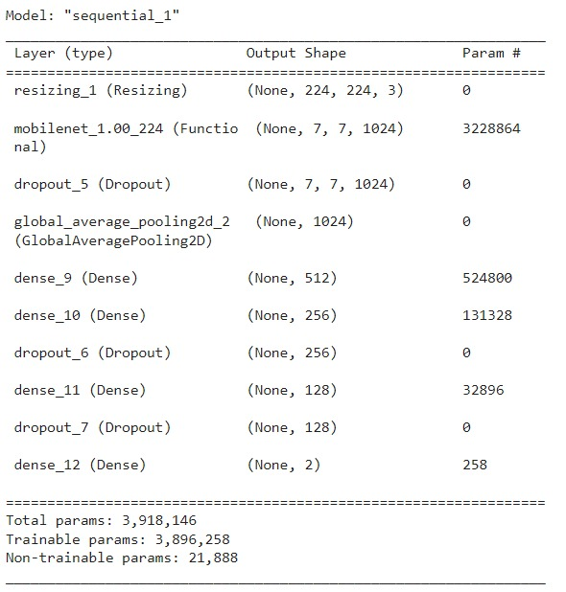
Models

Slide 20
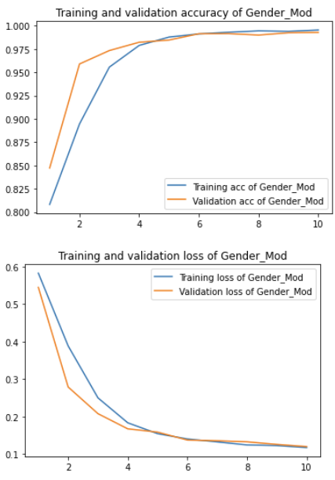
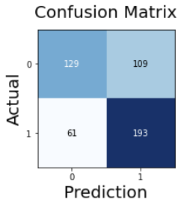
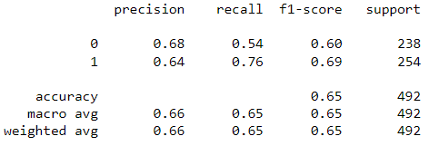
CNN Results
Male -> 0
Female -> 1

Slide 21
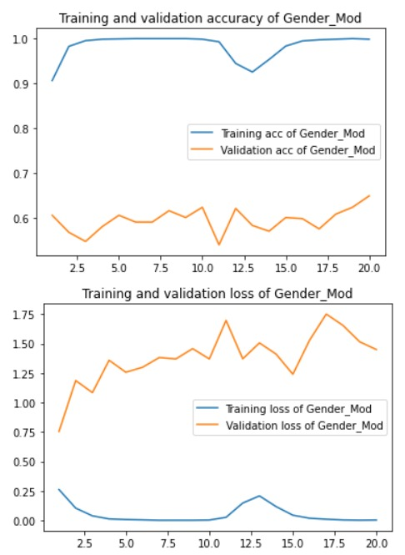
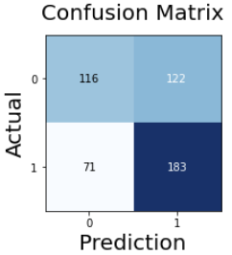
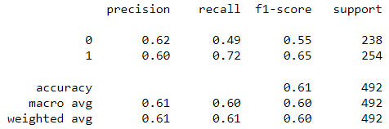
MobileNet Results

Slide 22
Alterations Classification
This problem is to classify the level of alteration which is performed on the Real fingerprint images.
For this problem, Altered data is considered as per the level of altering i.e., easy, medium and hard.
Total 49,270 data is used for train, test and validation split.

Slide 23
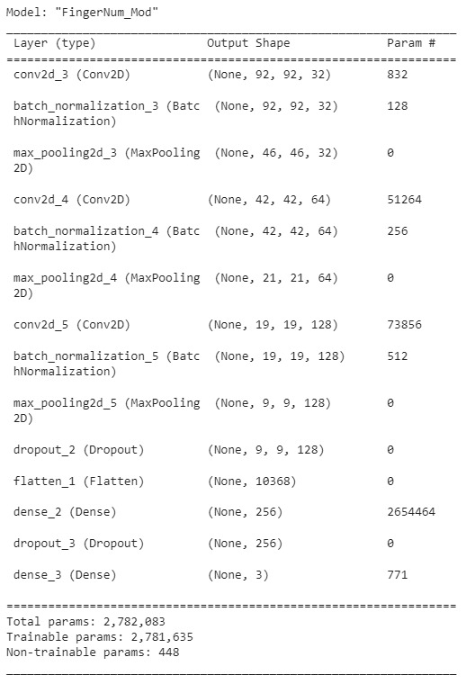
Models

Slide 24
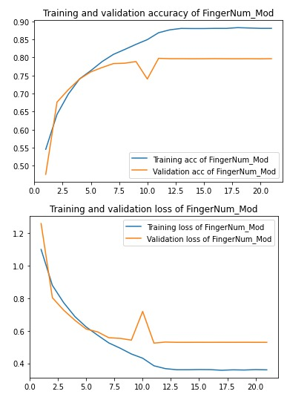
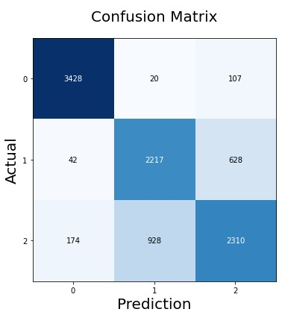
CNN Results

Slide 25
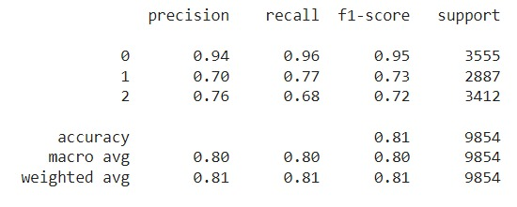
CNN Results

Slide 26
THANK YOU

